Slide 1

Normalization
COMP / IT 420 Lecture 6
March 1st, 2021

Slide 2
Class Outline For Today
Homework 1 ERD
Normalization Discussion
Normalization In-Class Assignment

Slide 3
Learning Objectives
Advanced Data Modeling
Normalization and its role in DB Design
Normal forms: 1NF, 2NF, 3NF, BCNF, and 4NF
How normal forms can be transformed from lower normal forms to higher normal forms
Situations where denormalization is preferred

Slide 4
Normalization
Evaluating table structures to minimize redundancy.
Reduces data anomalies and correct table structures.
Types:
First normal form (1NF)
Second normal form (2NF)
Third normal form (3NF)
Boyce-Codd normal form (BCNF)
Fourth normal form (4NF)

Slide 5
Database Anomalies
Data redundancy → Data anomalies (i.e. inconsistent data)
Insertion
Certain data cannot be inserted without the presence of other data.
Deletion
Certain data are lost because of the deletion of other data.
Update
One or more instances of duplicated data is updated, but not all.

Slide 6
Anomalies Examples
TABLE: COURSES
COURSE# (PK) | SECTION# (PK) | C_NAME
CSIT420 | 072 | Database Design
CSIT420 | 073 | Database Design
CSIT520 | 072 | Advanced Database Design
CSIT420 | 074 | Database Design

Slide 7
Insertion Anomaly
TABLE: COURSES
COURSE# (PK) | SECTION# (PK) | C_NAME
CSIT420 | 072 | Database Design
CSIT420 | 073 | Database Design
CSIT520 | 072 | Advanced Database Design
CSIT420 | 074 | Database Design
Suppose our university has approved a new course called CSIT421: SQL & PL/SQL. Can this information about the new course be entered into COURSE in its present form? Why?

Slide 8
Deletion Anomaly
TABLE: COURSES
COURSE# (PK) | SECTION# (PK) | C_NAME
CSIT420 | 072 | Database Design
CSIT420 | 073 | Database Design
CSIT520 | 072 | Advanced Database Design
CSIT420 | 074 | Database Design
Suppose not enough students enrolled for the course CSIT520 which had only one section 072. The school decides to drop this section and CSIT520 from the table COURSE.
Can this be accomplished? What are the consequences?

Slide 9
Update Anomaly
TABLE: COURSES
COURSE# (PK) | SECTION# (PK) | C_NAME
CSIT420 | 072 | Database Design
CSIT420 | 073 | Database Design
CSIT520 | 072 | Advanced Database Design
CSIT420 | 074 | Database Design
Suppose course name for CSIT420 is changed to Database Theory.
How many times do you have to make this change in the COURSE table in its current form?

Slide 10
Major Goal of Database Design
A table (relation) is stable (‘good’) only if it is free from any of these anomalies at any point in time.
Must ensure that each and every table is free from anomalies.
Accomplished through normalization.

Slide 11
Keys!!
Primary Key
???
Foreign Key
???
Super Key
???
Candidate Key
???
Secondary Key
???

Slide 12
Keys!!
Primary Key
Identifier composed of one or more attributes that uniquely identifies a row
Foreign Key
???
Super Key
???
Candidate Key
???
Secondary Key
???

Slide 13
Keys!!
Primary Key
Identifier composed of one or more attributes that uniquely identifies a row
Foreign Key
An attribute in one table whose values must match the primary key in another table, or be NULL
Super Key
???
Candidate Key
???
Secondary Key
???

Slide 14
Keys!!
Primary Key
Identifier composed of one or more attributes that uniquely identifies a row
Foreign Key
An attribute in one table whose values must match the primary key in another table, or be NULL
Super Key
An attribute or attributes that uniquely identify each entity in a table
Candidate Key
???
Secondary Key
???

Slide 15
Keys!!
Primary Key
Identifier composed of one or more attributes that uniquely identifies a row
Foreign Key
An attribute in one table whose values must match the primary key in another table, or be NULL
Super Key
An attribute or attributes that uniquely identify each entity in a table
Candidate Key
A minimal superkey, a key that cannot be reduced further without losing integrity
Secondary Key
???

Slide 16
Keys!!
Primary Key
Identifier composed of one or more attributes that uniquely identifies a row
Foreign Key
An attribute in one table whose values must match the primary key in another table, or be NULL
Super Key
An attribute or attributes that uniquely identify each entity in a table
Candidate Key
A minimal superkey, a key that cannot be reduced further without losing integrity
Secondary Key
A key used for data retrieval purposes, a specific use case

Slide 17
Quiz Super Key
year month date major minor
2008 01 13 0 1
2008 04 23 0 2
2009 11 05 1 0
2010 04 05 1 1
Which is a valid super key?
Year
Month and Date
Major
4. Minor
5. Major and Minor

Slide 18
Candidate and Super Key
year month date major minor
2008 01 13 0 1
2008 04 23 0 2
2009 11 05 1 0
2010 04 05 1 1
(year, month, date, major)
(year, major, minor)

Slide 19
Candidate and Super Key
year month date major minor
2008 01 13 0 1
2008 04 23 0 2
2009 11 05 1 0
2010 04 05 1 1
(year, month, date)
(major, minor)

Slide 20
Normalization
Decomposing a table into less redundant (and smaller) tables without losing information.
Foreign keys in the old table reference primary keys of the new ones.
Higher normal forms are better than lower normal forms
Denormalization: Produces a lower normal form
Results in increased performance and greater data redundancy

Slide 21
Need for Normalization
Normally performed during DB design:
Analyze relationships among attributes and entities
Determine if a structure can be improved
Break down entities into multiple sub-entities
Improve / Strengthen existing data structure
Normalizing existing databases is more difficult

Slide 22
Normalization Process
Ensures each table conforms to the concept of well-formed relations
Each table represents a single object
No complete data item is unnecessarily stored in more than one table
All nonprime attributes in a table are dependent on the primary key
Each table is void of insertion, update, and deletion anomalies

Slide 23
Normalization Process
Goal is generally Third Normal Form (3NF).
Higher forms are not likely to be encountered in common business environments.
Works one relation at a time.

Slide 24
Normalization Process
Begin by:
Identify entity dependencies (table-level).
Progressively breaking the relation into new sets relations.

Slide 25
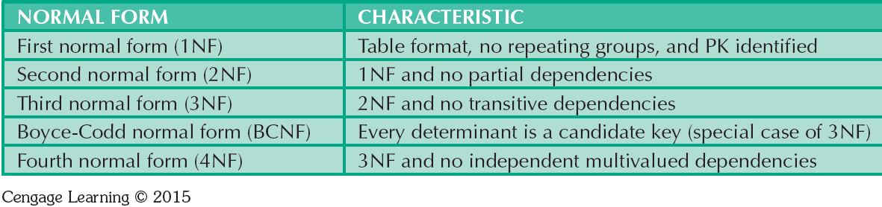
Normal Forms

Slide 26

Functional Dependence
Determination: Knowing one attribute determines the value of another attribute
Determinant: Attribute whose value determines another
DolphinId can determine student info including address information.
Dependent: Attribute whose value is determined by the other attribute
Student Name (FNAME + LNAME) or Address (STREET + APT + CITY + STATE + ZIP) is determined by DolphinId.
26

Slide 27
Functional Dependence
STU_DOLPHIN_ID -> STU_LNAME
Determinant
Dependent

Slide 28
Functional Dependence Concepts
Concept | Definition
Functional dependence | Attribute B is fully functionally dependent on the attribute A if each value of A determines one and only one value of B.
Full functional dependence (composite key) | If attribute B is functionally dependent on a composite key A but not on any Subset of that composite key, the attribute B is fully functionally dependent on A.

Slide 29
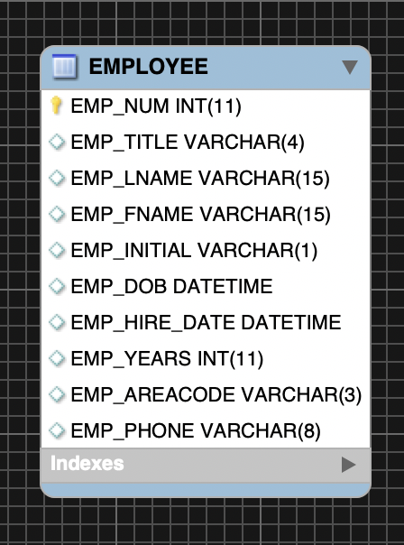
Functional Dependence (Example)
For Table “Employee”
What is the determinant?
Functional dependency {EMP_NUM} → {EMP_FNAME}
Functional dependency {EMP_NUM} → {EMP_LNAME}
Functional dependency {EMP_NUM} → {EMP_AREACODE}
Functional dependency {EMP_NUM} → {EMP_DOB}
Etc.

Slide 30
Dependencies: Definitions
Partial Dependency – Functional dependence in which a determinant is only part of the primary key
More straightforward and easy to identify
Partial Dependency

Slide 31
Dependencies: Definitions
Transitive Dependency – An attribute depends on another non-key attribute
Transitive Dependency

Slide 32
Conversion to First Normal Form
Identify and eliminate repeating groups
Group of multiple entries of same type can exist for any single key attribute occurrence
Steps:
Eliminate the repeating groups.
Identify a primary key.
Identify dependencies.

Slide 33
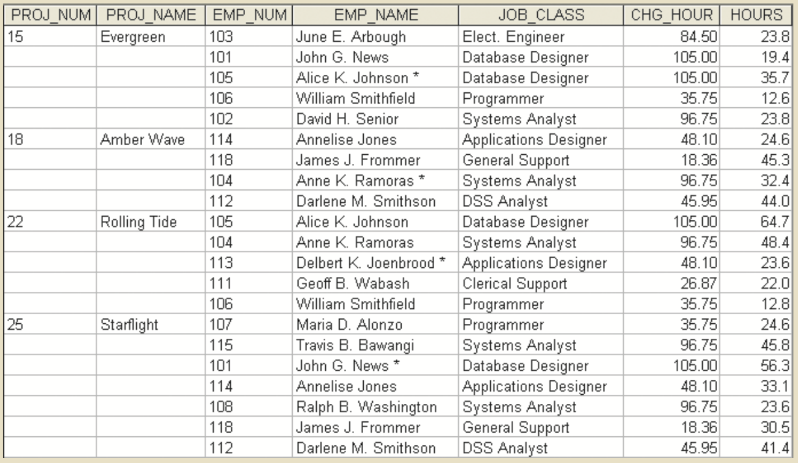
Repeating Groups
Repeating groups imply connection between data without explicit declaration

Slide 34
Conversion to First Normal Form (1NF)
1NF describes tabular format in which:
All key attributes are defined
There are no repeating groups in the table
All attributes are dependent on the primary key
All relational tables satisfy 1NF requirements
Tables may have partial and transitive dependencies
Subject to data redundancies and various anomalies

Slide 35
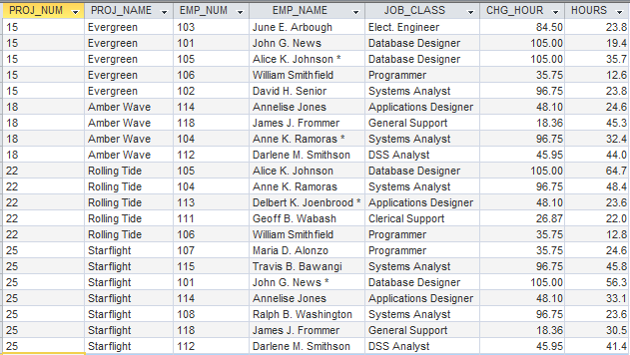
Moving to 1NF: ASSIGNMENT Table
(1NF) All rows comprise a unique instance of an entity.

Slide 36
Dependency Diagram
Depicts all dependencies found within given table structure
Overview of all relationships among table’s attributes
Makes it less likely that an important dependency will be overlooked

Slide 37
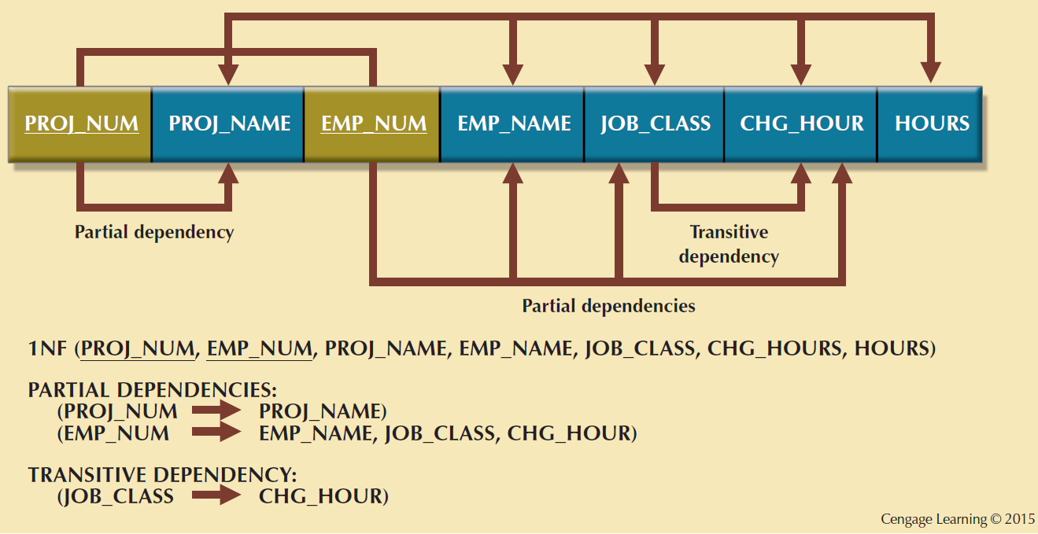
1NF Dependency Diagram

Slide 38
Conversion to Second Normal Form (2NF)
Steps
1. Make new tables to eliminate partial dependencies
2. Reassign corresponding dependent attributes
Table is in 2NF when it:
1. Is in 1NF
2. Includes no partial dependencies

Slide 39
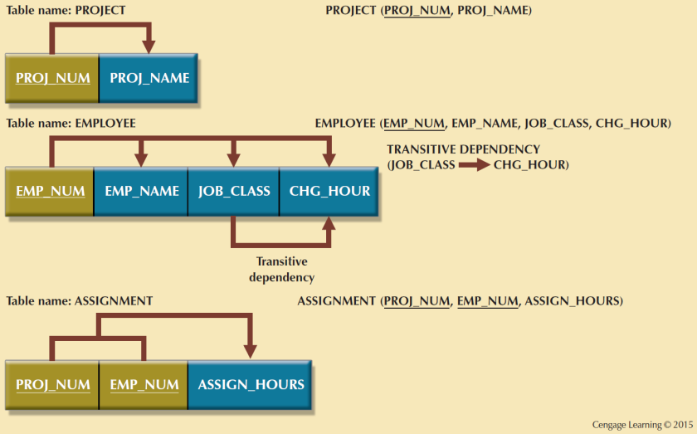
Second Normal Form (2NF) Conversion Results

Slide 40
Conversion to Third Normal Form (3NF)
Steps
1. Make new tables to eliminate transitive dependencies
2. Reassign corresponding dependent attributes
Table is in 3NF when it:
1. Is in 2NF
2. Contains no transitive dependencies

Slide 41
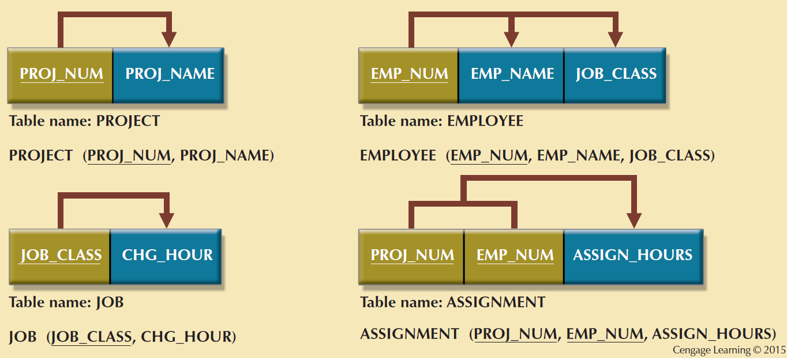
Third Normal Form (3NF) Conversion

Slide 42
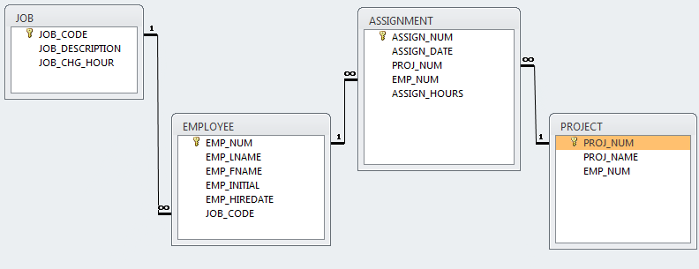
3NF Eliminated Transitive Dependencies

Slide 43
Requirements for Good Normalized Set of Tables
Evaluate PK assignments and naming conventions
Refine attribute atomicity
Atomic attribute: Cannot be further subdivided
Identify new attributes and relationships

Slide 44
Requirements for Good Normalized Set of Tables
Refine PKs for data granularity
Granularity: Level of detail represented by the values stored in a table’s row
Maintain historical accuracy and evaluate using derived attributes

Slide 45
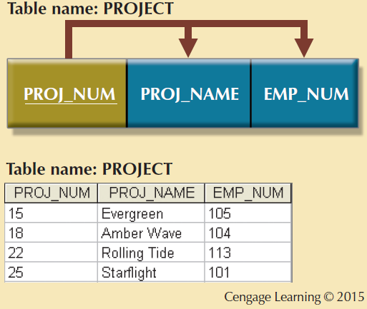
The Completed Database

Slide 46
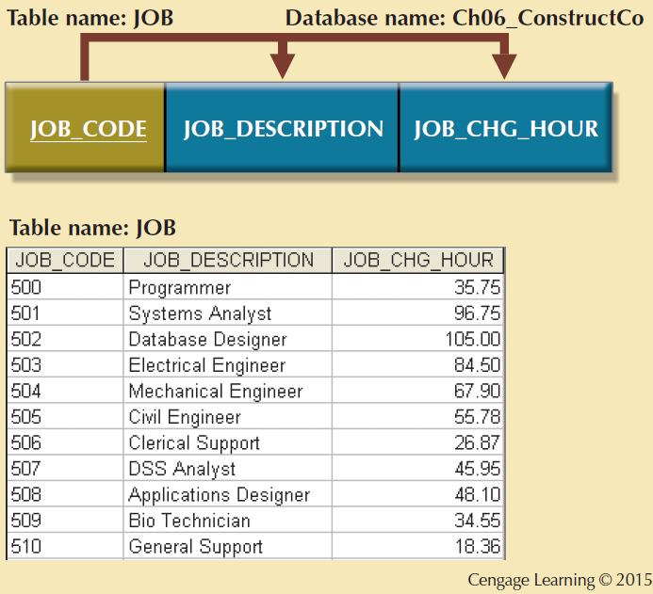

Slide 47
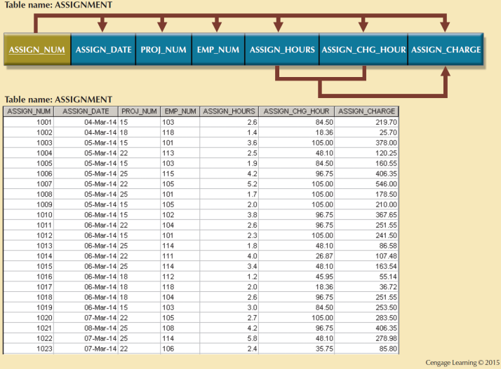

Slide 48
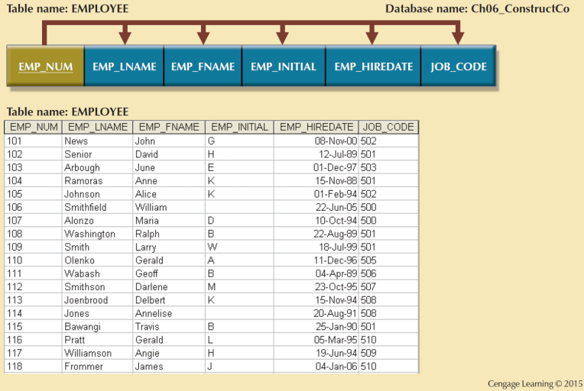

Slide 49
Surrogate Keys
System-defined attribute
Used by designers when the primary key is considered to be unsuitable
Created an managed via the DBMS
A numeric value which is automatically incremented for each new row
Can create anomalies without thoughtful use and indexing

Slide 50
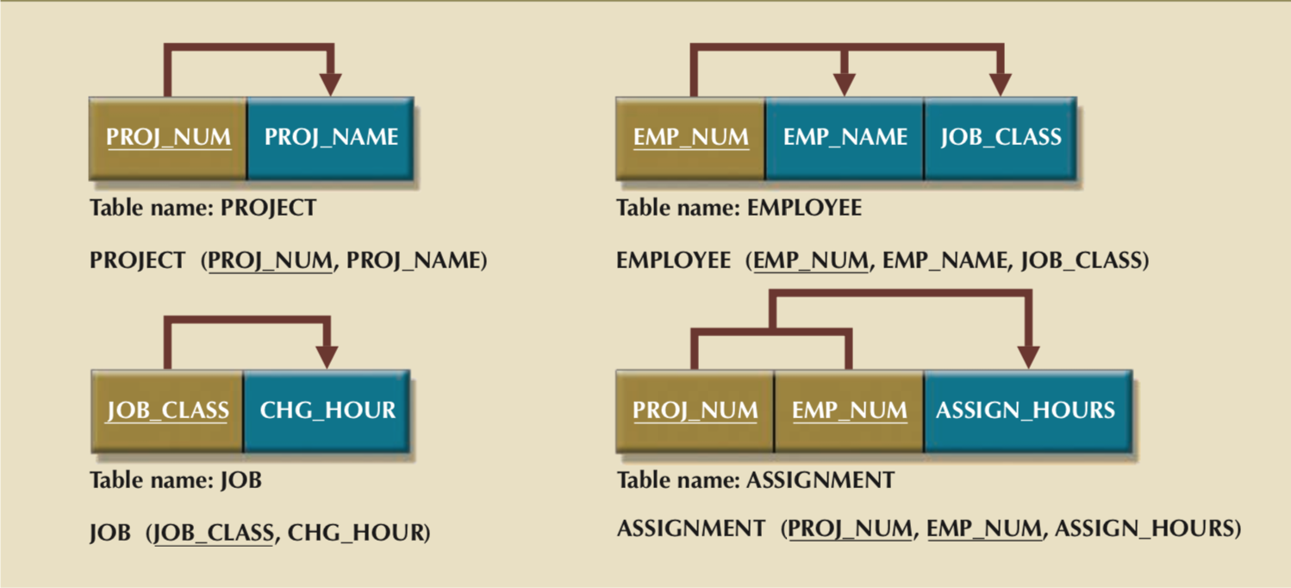
Third Normal Form (3NF) Results

Slide 51
JOB_CODE

Slide 52
Third Normal Form (3NF) Results

Slide 53
EMP_NUM

Slide 54
Boyce-Codd Normal Form (BCNF)
Every determinant in the table should be a candidate key
Candidate key - Same characteristics as primary key but not chosen to be the primary key
Equivalent to 3NF when the table contains only one candidate key
Can only be violated only when the table contains more than one candidate key
Considered to be a special case of 3NF

Slide 55
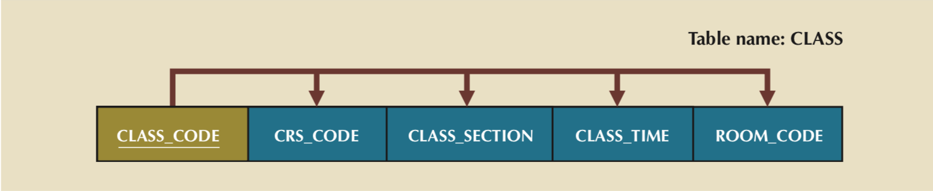
Candidate Key

Slide 56
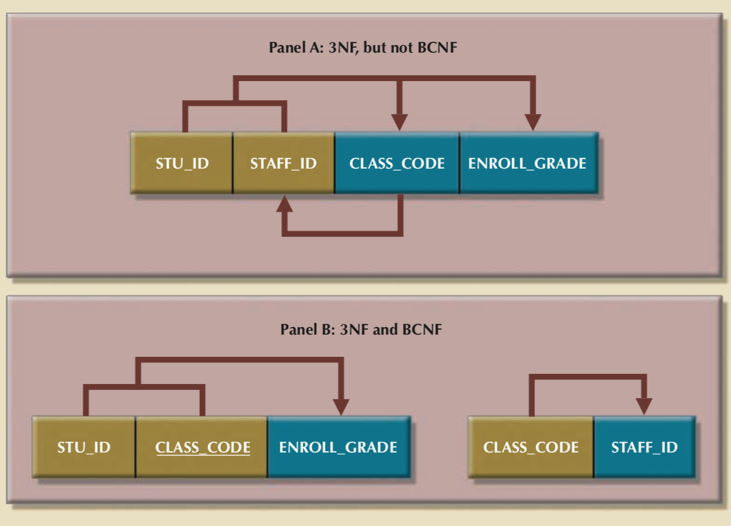

Slide 58
Fourth Normal Form (4NF)
Eliminates multi-valued dependencies
Combination of values are dependent in relation but independent of each other in application
May occur in business situations
Depends on interpretation of data, like other normalization schemes

Slide 59
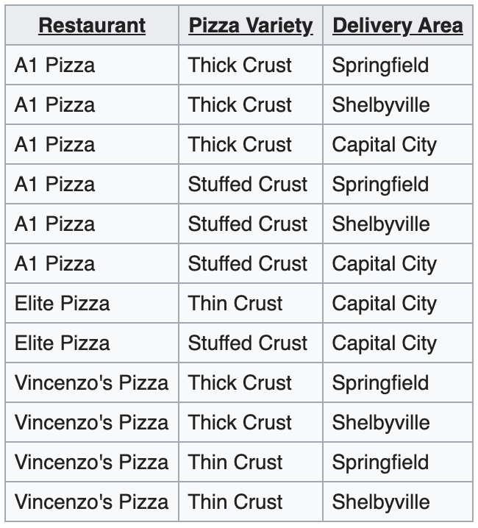
PIZZA EXAMPLE!
X Y Z
In 3NF and BCNF due to
a single candidate key:
(Restaurant, Pizza Variety, Delivery Area)
No partial dependencies
No transitive dependencies
Redundancies!
X -> Y is independent of X -> Z
so multiple values are dependent in
table that should probably not be

Slide 60
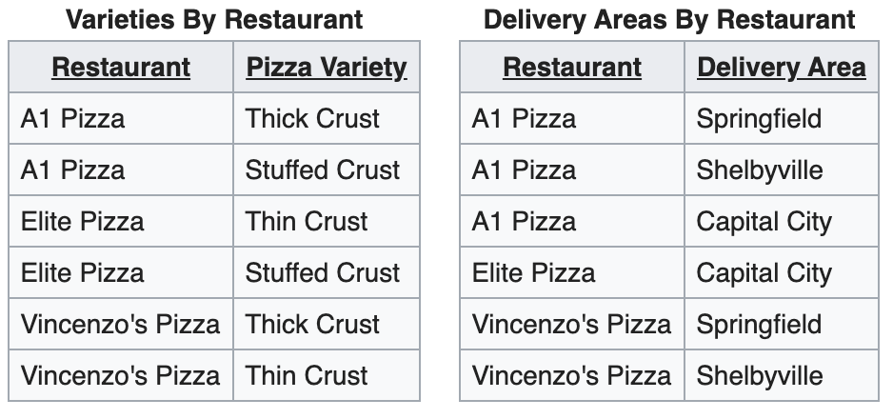

Slide 61
Normalization and Database Design
Normalization should be part of the design process
Proposed entities must meet required normal forms before table structures are created
Principles and normalization procedures must be understood to redesign and modify databases
ERD is created through an iterative process
Normalization focuses on the characteristics of specific entities

Slide 62
Denormalization
Design goals
Creation of normalized relations.
Processing requirements and speed.
Number of database tables expands when tables are decomposed to conform to normalization requirements.
Joining a larger number of tables:
Takes additional input/output (I/O) operations and processing logic
Reduces system speed

Slide 63
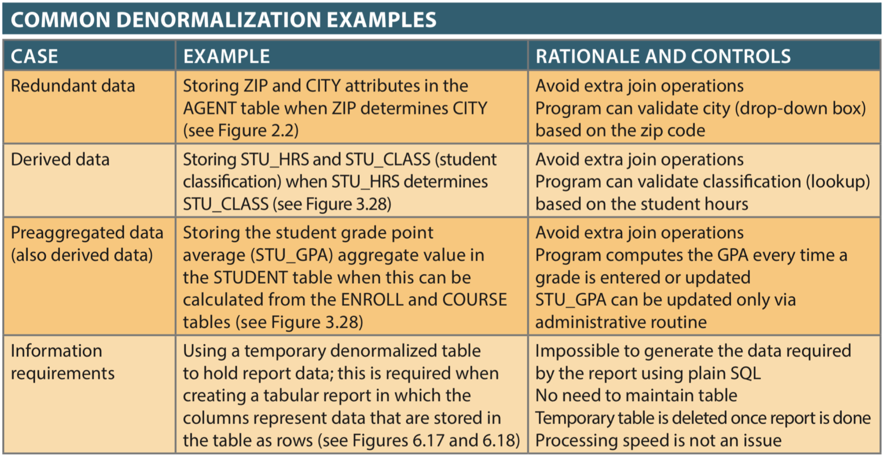

Slide 64
Denormalization
Defects in unnormalized tables
Data updates are less efficient because tables are larger
Indexing is more cumbersome
No simple strategies for creating virtual tables known as views.

Slide 65
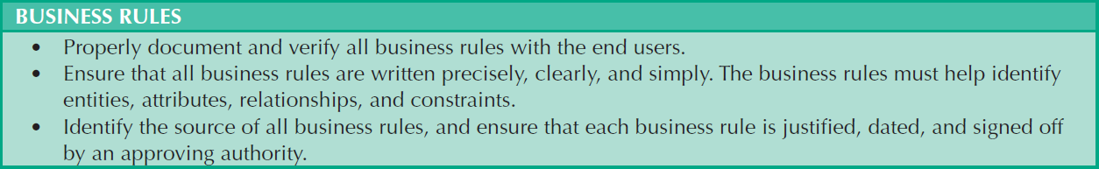
Data-Modeling Checklist
Cengage Learning © 2015

Slide 66
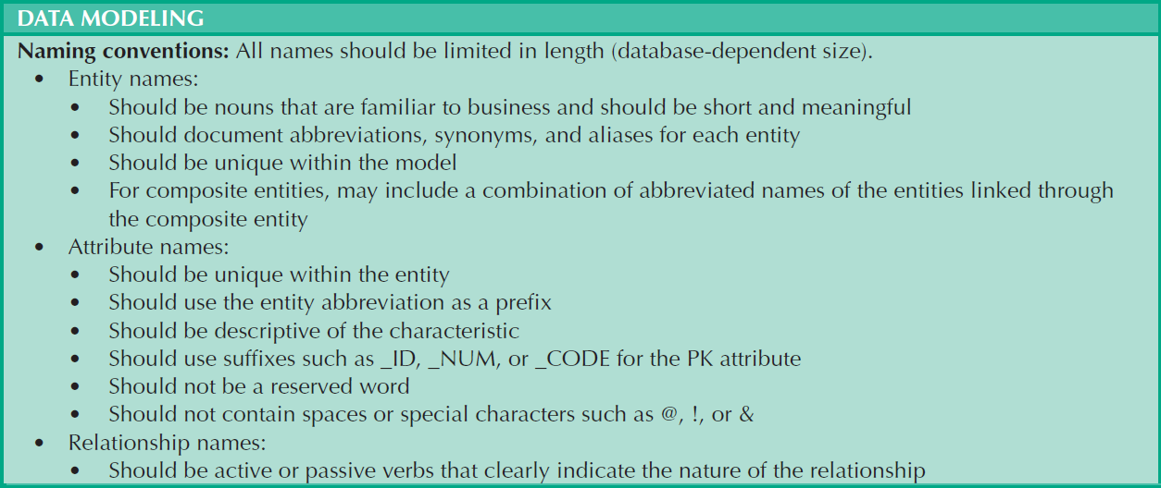
Data-Modeling Checklist
Cengage Learning © 2015

Slide 67
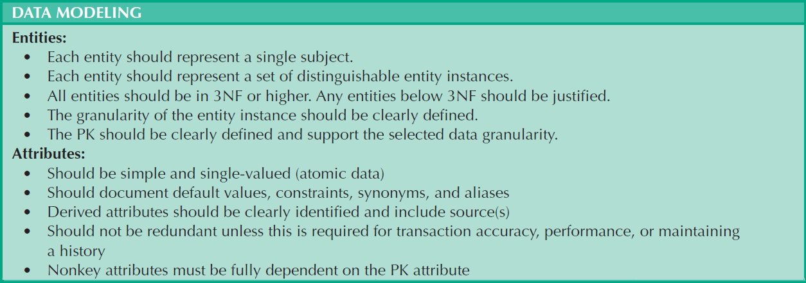
Data-Modeling Checklist
Cengage Learning © 2015

Slide 68
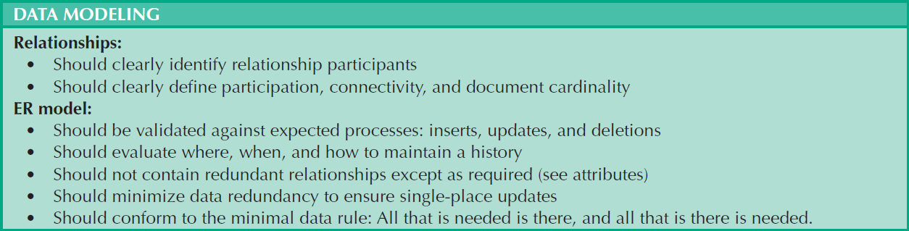
Data-Modeling Checklist
Cengage Learning © 2015

Slide 69


Slide 70
In which normal form?
What are the partial dependencies?
What are the transitive dependencies?

